Slide 1







The National Audit of Breast Cancer in Older Patients (NABCOP)
2020 Annual Report
[Insert name of presenter]
[Insert name of event]
[Insert name of NHS organisation]
www.nabcop.org.uk
nabcop@rcseng.ac.uk
#NABCOP2020
@NABCOP_news

Slide 2




What is this slide set for?
To summarise organisation-level findings from the NABCOP annual report, for presentation at local MDT or clinical governance meetings.
  Review your NHS organisation results for the NABCOP as a team.
  These can be found in the NHS Organisation Data Viewer, downloadable from:
  https://www.nabcop.org.uk/resources/nabcop-2020-annual-report-supplementary-materials
  How do you compare to all NABCOP NHS organisations?
  Discuss quality improvement for your unit.
See the notes section of each slide for details on how to
insert your organisations results and graphs.
@NABCOP_news
Notes:
This slide-set is to allow NHS organisations to present their individual results from the NABCOP 2020 Annual Report. You can download your organisations results from our NABCOP Organisation Data Viewer, available on the NABCOP website, alongside a guide to using the data viewer.
Link to 2020 Annual Report: https://www.nabcop.org.uk/reports/nabcop-2020-annual-report/
Within this presentation, you will also find our 16 recommendations from the NABCOP 2020 annual report, which we make on the basis of our findings. There are some discussion slides where you may want to talk through the results which you have just presented, and whether any action needs taking within your unit.

Slide 3


What is the NABCOP?
The NABCOP is a collaboration between ABS & RCSEng
  Commissioned by HQIP as part of the National Clinical Audit and Patient Outcomes Programme (NCAPOP)
  Started in April 2016
Aim: Audit breast cancer care received by older women
(aged 70+ yrs) in NHS organisations in England & Wales
  Compare with care received by younger women (aged 50–69 years)
Uses existing routine data sources
@NABCOP_news
Notes:
ABS – Association of Breast Surgery. Represents healthcare professionals treating malignant and benign breast disease in the UK, Ireland and worldwide.
RCSEng -The Royal College of Surgeons of England. Independent professional body committed to enabling surgeons to achieve and maintain the highest standards of surgical practice and patient care. As part of this it supports audit and the evaluation of clinical effectiveness for surgery.
HQIP – Healthcare quality improvement Partnership. Aims to promote quality improvement in healthcare, and in particular to increase the impact of clinical audit on the services provided by the NHS and independent healthcare organisations.

Slide 4



What data do the NABCOP use?
Existing national datasets provided by NCRAS in England &
the Wales Cancer Network (WCN)*
  No audit-specific database
  No additional data entry required from NHS organisations
Data from all NHS hospitals in England & Wales
Women diagnosed from 2014 onwards
*Full details at https://www.nabcop.org.uk/resources/nabcop-combined-data-specification/
@NABCOP_news
Notes:
The National Cancer Registration and Analysis Service (NCRAS) collates patient data from a number of national data feeds across all NHS acute hospitals. Data on Welsh patients are provided by the Wales Cancer Network using the Cancer Network Information System Cymru (Canisc) electronic patient record system.
* Further information on the data items that the NABCOP uses for analysis can be found here

Slide 5
Full details of the NABCOP 2020 results online*
Included results show differences by NHS organisation for:
  Triple diagnostic assessment in a single visit
  Contact with a breast clinical nurse specialist (CNS)
  Treatment for ductal carcinoma in situ (stage 0)
  Treatment for early invasive breast cancer (stage 1–3A)
  Metastatic breast cancer (stage 4)
*For further information and to read the full 2020 annual report online, visit: https://www.nabcop.org.uk/reports/nabcop-2020-annual-report/
@NABCOP_news
Notes:
For further information and to read the full 2020 annual report online, visit: https://www.nabcop.org.uk/reports/nabcop-2020-annual-report/

Slide 6

Recommendations – Fitness assessment
Recs 1+2
Ensure all patients aged 70 years and over, at the initial clinic visit for suspicion of breast cancer, have the following information recorded:
  Clinical Frailty Scale
  Abbreviated Mental Test Score
  Indication of whether the patient has an established diagnosis of dementia and severe comorbidities
  Strive to submit the fitness assessment data items to NCRAS as part of COSD v9.0 submissions*
Rec
1
Rec
2
For further information on the NABCOP fitness assessment form, please visit: https://www.nabcop.org.uk/resources/fitness-assessment-tool/
*COSD data collection only applicable to English NHS organisations. The WCN has confirmed that the fitness data items captured by COSD (in England) will become a mandatory part of the Welsh dataset in the future.
@NABCOP_news
Notes:
See chapter 3 of the 2020 annual report to read about the work the NABCOP is doing into measuring fitness for older women with breast cancer.
Note: Recommendation 2 is only for English NHS organisations, as the fitness assessment is not yet available to be collected within routine data sources in Wales.

Slide 7

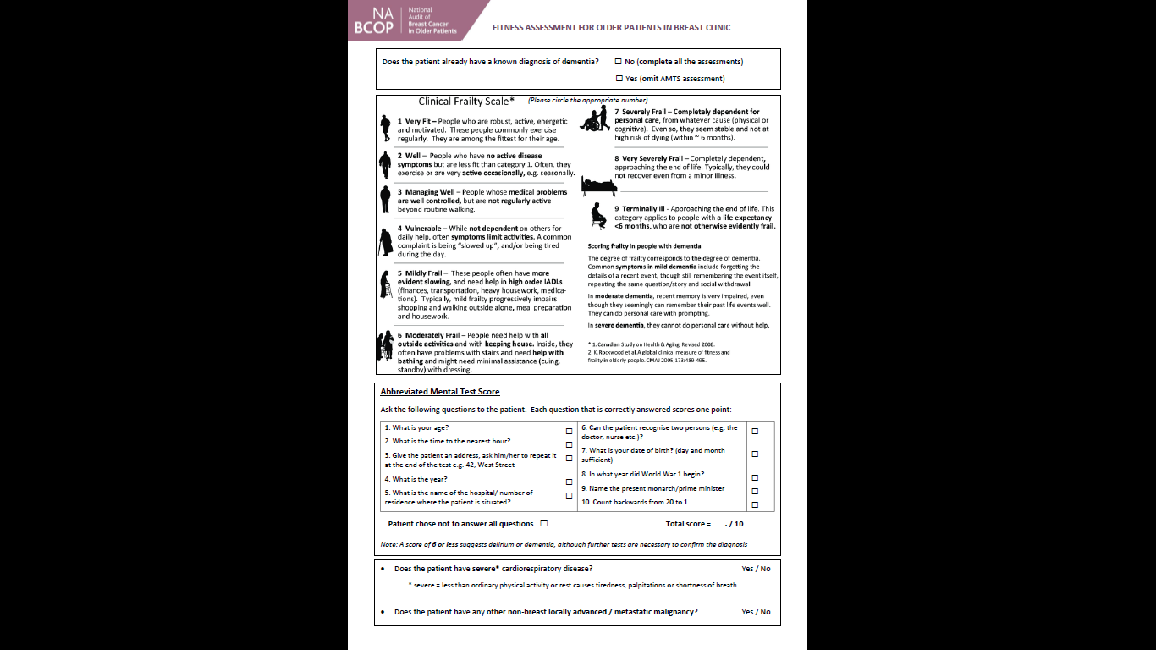


What can we do to action these recommendations?
Recs 1+2
Visit https://www.nabcop.org.uk/resources/fitness-assessment-tool/
Download the NABCOP frailty assessment form.
Complete the information for the patient, and keep it with their records.
@NABCOP_news

Slide 8
Recommendations – data completeness and recorded molecular marker status
Recs 3-6
Rec
3
Identify a clinician responsible for reviewing and feeding back, to staff within their breast units, on their data returns.
Review data uploads regularly, and ensure the following are uploaded to NCRAS/Canisc:
  Tumour size
  TNM stage
  WHO performance status
  ER & HER2 status for invasive breast cancer
Review how to improve the recording of recurrence in local medical records and ensure this information is uploaded to NCRAS and Canisc.
Carry out and record full tumour characterisation, including assessment of ER and HER2 status, for all patients with invasive breast cancer for use at multidisciplinary team meetings; in line with NICE guidance.
Rec
4
Rec
5
Rec
6
@NABCOP_news
Notes:
For further information about recommendations 3 and 4, see chapter 4
For further information about recommendation 5, see chapter 10
For further information about recommendation 6, see chapter 5

Slide 9
Availability of core data items for [insert organisation name] in [insert selected year]
Ensure red line is on 90% to highlight areas where data completeness falls below this value
@NABCOP_news
Notes:
Instructions:
Delete the current graph in this slide.
Download the NHS organisation data viewer for the Annual Report from the website: https://www.nabcop.org.uk/resources/nabcop-2020-annual-report-supplementary-materials
On the ‘CONTENTS’ page, select your NHS organisation in the drop down option in ‘Click in the cell below to scroll & pick the NHS organisation you want to be highlighted in the subsequent tabs:’
Go to the sheet ‘Data Quality’ and select the year you would like to review from the ‘Time period’ drop down option.
Go to the sheet `DQ_Summary’ and copy the bar graph of your organisations data completeness to this slide
Move the red line to be on 90% to highlight in your presentation the data items where your NHS organisation falls below 90%.

Slide 10
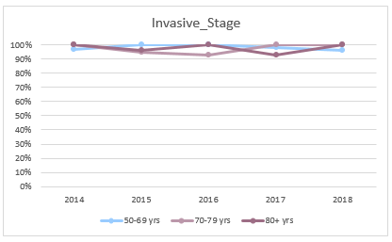
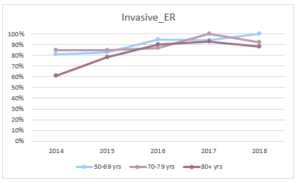
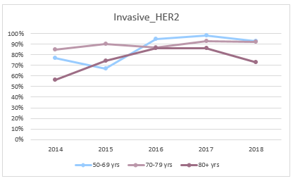
Data quality over time for [insert organisation name]
Invasive stage
ER status
HER2 status
@NABCOP_news
Notes:
Instructions:
Delete the current graphs in this slide.
Download the NHS organisation data viewer for the Annual Report from the website: https://www.nabcop.org.uk/resources/nabcop-2020-annual-report-supplementary-materials
On the ‘CONTENTS’ page, select your NHS organisation in the drop down option in ‘Click in the cell below to scroll & pick the NHS organisation you want to be highlighted in the subsequent tabs:’
Go to the sheet ‘DQ_Time’ and select the data item you would like to review from the ‘Selected data item’ drop down option. There are several data items you can choose from, the data items on this slide are shown for demonstration purposes.
Press the ‘Print Screen’ button on your keyboard, and paste the image into this slide. Crop the image to just contain the graph.

Slide 11
Recording of breast cancer recurrence over time
Rec
5
Review how to improve the recording of recurrence in local medical records and ensure this information is uploaded to NCRAS and Canisc.
@NABCOP_news
Notes:
Instructions:
Delete the current graph in this slide.
Download the NHS organisation data viewer for the Annual Report from the website: https://www.nabcop.org.uk/resources/nabcop-2020-annual-report-supplementary-materials
On the ‘CONTENTS’ page, select your NHS organisation in the drop down option in ‘Click in the cell below to scroll & pick the NHS organisation you want to be highlighted in the subsequent tabs:’
Go to the sheet ‘Recurrence_Time’ and copy and paste the graph into this slide.

Slide 12

Discussion – how can we improve our data completeness?
What is our current method of uploading data items to cancer registration databases?
What steps can be taken to ensure the key data items are completed for patients?
Do we have an allocated staff member responsible for checking data uploads?
@NABCOP_news
Notes:
This slide is designed if you wish to discuss the key points regarding your organisations data completeness which have arisen from the previous few slides. This slide is designed as a guide – please change/adapt it to your organisations requirements as you see fit.
Visit the ‘Improving data completeness section of our website (https://www.nabcop.org.uk/resources/improving-data-completeness/) for ideas to implement in your organisation.
For organisations in England we have some case studies from trusts on achieving high levels of COSD completeness (https://www.nabcop.org.uk/resources/cosd-data-case-studies/).

Slide 13
Recommendations – diagnosis & supportive care
Recs 7-10
Ensure women receive all components of the triple diagnostic assessment (TDA) at their initial clinic visit for suspected breast cancer.
  Submit data on TDA to NCRAS as part of COSD v9*
Ensure that women are assigned a named breast clinical nurse specialist (CNS) to provide information & support; submit data on this assignment to NCRAS or Canisc.
Ensure patients have sufficient information about their care & treatment(s) and are engaged in a shared-decision making process by asking patients for feedback at regular intervals.
Recs 7-8
Rec
9
Rec
10
*COSD data collection only applicable to English NHS organisations. Records of clinical examination, biopsy and imaging (TDA) by Welsh local health boards should continue to be submitted via Canisc data returns.
@NABCOP_news
Notes:
For more information on supportive care, see chapter 6 of the 2020 Annual Report: https://www.nabcop.org.uk/reports/nabcop-2020-annual-report/
Note: The data item on TDA in a single visit is only being collected for English NHS organisations at present.

Slide 14
How can we improve the diagnosis pathway for our patients?
Receipt of TDA in a single visit for women at [insert your organisation name], by age group.
For discussion:
  How can we improve the number of women receiving TDA in a single visit?
  Does our data accurately reflect what is happening in clinical practice?
TDA (strict criteria)
TDA (relaxed criteria)
@NABCOP_news
Notes:
For more information on supportive care, see chapter 6 of the 2020 Annual Report: https://www.nabcop.org.uk/reports/nabcop-2020-annual-report/
Instructions:
Delete the current graph in this slide.
Download the NHS organisation data viewer for the Annual Report from the website: https://www.nabcop.org.uk/resources/nabcop-2020-annual-report-supplementary-materials
On the ‘CONTENTS’ page, select your NHS organisation in the drop down option in ‘Click in the cell below to scroll & pick the NHS organisation you want to be highlighted in the subsequent tabs:’
Go to the sheet `Chp6_TDA’ and copy the bar graph of your organisations data to this slide
Note: For further information about the relaxed and strict criteria which the NABCOP uses to define TDA in a single visit, see chapter 6.2 in the 2020 annual report.

Slide 15
How can we improve the supportive care our patients receive?
For discussion:
What is our unit procedure for assigning a breast CNS; are we making sure the patient has contact and it is noted where the patient refuses?
How do we get feedback from our patients to make sure they
understand their treatment
choices?
CNS contact reported as “Yes”
@NABCOP_news
Notes:
For more information on supportive care, see chapter 6 of the 2020 Annual Report: https://www.nabcop.org.uk/reports/nabcop-2020-annual-report/
Instructions:
Delete the current graph in this slide.
Download the NHS organisation data viewer for the Annual Report from the website: https://www.nabcop.org.uk/resources/nabcop-2020-annual-report-supplementary-materials
On the ‘CONTENTS’ page, select your NHS organisation in the drop down option in ‘Click in the cell below to scroll & pick the NHS organisation you want to be highlighted in the subsequent tabs:’
Go to the sheet `Chp6_CNS’ and copy the bar graph of your organisations data to this slide

Slide 16
What is the rate of surgery for ductal carcinoma in situ (DCIS) between 2014 – 2018?
Risk adjusted rates of surgery (%)
Rec
11
Consider adopting a more prescriptive policy concerning the management of DCIS that covers the use of surgery & adjuvant therapies in older women, in the context of any comorbidities & frailty.
@NABCOP_news
Notes:
For more information on DCIS, see section 7 of the 2020 Annual Report: https://www.nabcop.org.uk/reports/nabcop-2020-annual-report/
Instructions:
Delete the current graph in this slide.
Download the NHS organisation data viewer for the Annual Report from the website: https://www.nabcop.org.uk/resources/nabcop-2020-annual-report-supplementary-materials
On the ‘CONTENTS’ page, select your NHS organisation in the drop down option in ‘Click in the cell below to scroll & pick the NHS organisation you want to be highlighted in the subsequent tabs:’
Go to the sheet `Chp7_DCIS_Surgery’ and copy the graph from the data viewer and paste it into this slide.

Slide 17
What is the rate of radiotherapy for DCIS between 2014 – 2018?
Observed rates of radiotherapy (%)
Rec
11
Consider adopting a more prescriptive policy concerning the management of DCIS that covers the use of surgery & adjuvant therapies in older women, in the context of any comorbidities & frailty.
@NABCOP_news
Notes:
For more information on DCIS, see section 7 in the NABCOP 2020 Annual Report: https://www.nabcop.org.uk/reports/nabcop-2020-annual-report/
Instructions:
Delete the current graph in this slide.
Download the NHS organisation data viewer for the 2020 Annual Report from the website: https://www.nabcop.org.uk/resources/nabcop-2020-annual-report-supplementary-materials
On the ‘CONTENTS’ page, select your NHS organisation in the drop down option in ‘Click in the cell below to scroll & pick the NHS organisation you want to be highlighted in the subsequent tabs:’
Go to the sheet `Chp7_DCIS_RT’ and copy the graph from the data viewer and paste it into this slide.

Slide 18
What is the rate of surgery for early invasive breast cancer (EIBC) between 2014 – 2018?
Risk adjusted rates of surgery (%)
Rec
12
Investigate and address any shortfalls in care within NHS organisations with a comparatively low rate of surgery for women aged 70+ years with ER positive breast cancer.
@NABCOP_news
Notes:
For more information on surgery early invasive BC, see section 8.1 in the NABCOP 2020 Annual Report: https://www.nabcop.org.uk/reports/nabcop-2020-annual-report/
Instructions:
Delete the current graph in this slide.
Download the NHS organisation data viewer for the 2020 Annual Report from the website: https://www.nabcop.org.uk/resources/nabcop-2020-annual-report-supplementary-materials
On the ‘CONTENTS’ page, select your NHS organisation in the drop down option in ‘Click in the cell below to scroll & pick the NHS organisation you want to be highlighted in the subsequent tabs:’
Go to the sheet `Chp8_EIBC_Surgery’ and copy the graph from the data viewer and paste it into this slide.

Slide 19
What is the rate of radiotherapy for EIBC between 2014 – 2018?
BCS followed by RT
Mastectomy followed by RT
Rec
13
Counsel women with high risk early invasive BC on the benefits & risks of adjuvant radiotherapy, based on tumour characteristics & objective assessment of patient fitness, rather than chronological age alone.
@NABCOP_news
Note: Use of RT after Mx analysed for women with high risk cancer, classified as N+ or T3-T4 N0 breast cancer
Notes:
For more information on radiotherapy early invasive BC, see section 8.2 in the NABCOP 2020 Annual Report: https://www.nabcop.org.uk/reports/nabcop-2020-annual-report/
Instructions:
Delete the current graph in this slide.
Download the NHS organisation data viewer for the 2020 Annual Report from the website: https://www.nabcop.org.uk/resources/nabcop-2020-annual-report-supplementary-materials
On the ‘CONTENTS’ page, select your NHS organisation in the drop down option in ‘Click in the cell below to scroll & pick the NHS organisation you want to be highlighted in the subsequent tabs:’
Go to the sheet `Chp8_EIBC_RT’ and copy the graph from the data viewer and paste it into this slide.

Slide 20
What is the rate of post-operative chemotherapy & trastuzumab* for EIBC between 2014 – 2018?
Risk adjusted rates of chemotherapy (%)
Rec
14
Provide an objective assessment of the anticipated benefits and risks of chemotherapy, based on tumour factors and patient fitness, for all women, irrespective of age, with:
ER negative, HER2 negative early invasive breast cancer with malignant lymph nodes or
HER2 positive early invasive breast cancer.
*Only applicable to English NHS organisations. This data was not available from Welsh local health boards (Canisc) at the time of producing the most recent report.
@NABCOP_news
Notes:
For more information on chemotherapy early invasive BC, see chapter 8.3 in the NABCOP 2020 Annual Report: https://www.nabcop.org.uk/reports/nabcop-2020-annual-report/
Note: This slide is only applicable to those women diagnosed in English NHS organisations.
Instructions:
Delete the current graph in this slide.
Download the NHS organisation data viewer for the 2020 Annual Report from the website: https://www.nabcop.org.uk/resources/nabcop-2020-annual-report-supplementary-materials
On the ‘CONTENTS’ page, select your NHS organisation in the drop down option in ‘Click in the cell below to scroll & pick the NHS organisation you want to be highlighted in the subsequent tabs:’
Go to the sheet `Chp8_EIBC_HER2CT’ and copy the graph from the data viewer and paste it into this slide.

Slide 21
Discussion – DCIS/early invasive breast cancer treatment
How do our rates of surgery compare with other units?
What are our procedures for assessing our patients for adjuvant radiotherapy to make sure chronological age is not the primary factor?
How do our rates of adjuvant chemotherapy & trastuzumab compare with other units for our patients with HER2+ EIBC?*
*Only applicable to English NHS organisations. Data on use of biological agents was not available from Welsh local health boards (Canisc) at the time of producing the most recent report.
@NABCOP_news
Notes:
This slide is designed if you wish to discuss the key points regarding your organisations data which have arisen from the previous few slides. This slide is designed as a guide – please change/adapt it to your organisations requirements as you see fit.

Slide 22
Endocrine therapy for newly diagnosis metastatic (M1) breast cancer between 2014 - 2018
5% of women had metastatic BC at presentation
  3% of women aged 50-69 years
  7% of women aged 70+ years
79% of women with metastatic BC were ER positive*
Rates of endocrine treatment for ER positive women differed by age:
  57% in women aged 50—69 years
  75% in women aged 70—79 years
  83% in women aged 80+ years
Rec
15
Ensure that all women with metastatic breast cancer have their tumour’s ER status assessed and recorded; those with ER positive breast cancer should be offered endocrine therapy as part of their treatment package.
@NABCOP_news
*Among women with a known ER status, information taken from the 2020 Annual Report
Notes:
For more information on endocrine therapy for metastatic breast cancer, see section 9 in the NABCOP 2020 Annual Report: https://www.nabcop.org.uk/reports/nabcop-2020-annual-report/

Slide 23
What is the rate of chemotherapy for patients with newly diagnosed M1 breast cancer between 2014 - 2018?
Women aged 70+ years were less likely to receive chemotherapy irrespective of fitness or ER status
  46% of women aged 50-69 years
  19% of women aged 70+ years
Rec
16
Risk adjusted rates of chemotherapy (%)
Ensure that, for women considered for chemotherapy, there is an objective assessment of potential benefit and predicted life expectancy. Consideration should not be based on chronological age alone.
@NABCOP_news
Notes:
For more information on chemotherapy for metastatic breast cancer, see section 9 in the NABCOP 2020 Annual Report: https://www.nabcop.org.uk/reports/nabcop-2020-annual-report/
Instructions:
Delete the current graph in this slide.
Download the NHS organisation data viewer for the 2020 Annual Report from the website: https://www.nabcop.org.uk/resources/nabcop-2020-annual-report-supplementary-materials
On the ‘CONTENTS’ page, select your NHS organisation in the drop down option in ‘Click in the cell below to scroll & pick the NHS organisation you want to be highlighted in the subsequent tabs:’
Go to the sheet `Chp9_M1_CT’ and copy and paste the graph for your NHS organisation into this slide.

Slide 24
Discussion – newly diagnosed M1 breast cancer
Are we assessing ER status in women with metastatic breast cancer?
What are our current methods for assessing life expectancy and patient fitness in older women with metastatic breast cancer?
How do our rates of chemotherapy for patients with newly diagnosed metastatic breast cancer compare with other units?
@NABCOP_news
Notes:
This slide is designed if you wish to discuss the key points regarding your organisations data which have arisen from the previous few slides. This slide is designed as a guide – please change/adapt it to your organisations requirements as you see fit.

Slide 25
Summary of NABCOP data for [insert your organisation name]
Our data completion for core NABCOP data items :
In comparison to the national average, our rate of:
  Surgery for DCIS is higher / lower / comparable (delete as appropriate)
  Surgery for women aged 50-74 / 75 and over with ER-positive / ER-negative EIBC is higher / lower / comparable (delete as appropriate)
  Radiotherapy post-BCS for EIBC is higher / lower / comparable (delete as appropriate)
  Adjuvant chemotherapy + trastuzumab for women with HER2-positive EIBC is higher / lower / comparable (delete as appropriate)*
 | 50-69 years | 70-79 years | 80+ years
Tumour size | % | % | %
N-stage | % | % | %
M-stage | % | % | %
ER-status | % | % | %
HER-2 status | % | % | %
WHO performance status | % | % | %
*Only applicable to English NHS organisations. This data was not available from Welsh local health boards (Canisc) at the time of producing the most recent report.
@NABCOP_news
Notes:
Instructions:
For key point 1:
- Download the NHS organisation data viewer for the 2020 Annual Report from the website: https://www.nabcop.org.uk/resources/nabcop-2020-annual-report-supplementary-materials
- On the ‘CONTENTS’ page, select your NHS organisation in the drop down option in ‘Click in the cell below to scroll & pick the NHS organisation you want to be highlighted in the subsequent tabs:’
- Go to the sheet ‘Data Quality’ and select the year you have reviewed from the ‘Time period’ drop down option.
- Go to the sheet ‘DQ_Summary’ and copy the percentages across for each data item within each age group.
Refer to slide 13 for key point 2(i)
Refer to slide 15 for key point 2(ii)
Refer to slide 16 for key point 2(iii)
Refer to slide 17 for key point 2(iv) – note this is only for women diagnosed in England.

Slide 26
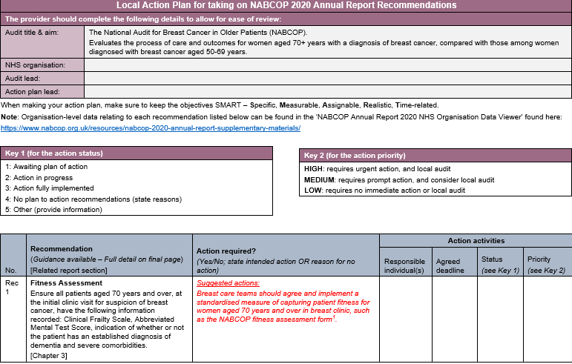
Local plan of action for NABCOP
@NABCOP_news
Notes:
We suggest using this slide to discuss your local plan of action for the NABCOP. You may want to complete the ‘NABCOP Local Action Plan’ which is a template for organisations to document and map out any changes within their organisation based on the NABCOP recommendations: https://www.nabcop.org.uk/resources/nabcop-2020-annual-report-supplementary-materials

Slide 27
www.nabcop.org.uk
nabcop@rcseng.ac.uk
@NABCOP_news

